Slide 1
Chapter 8 Network Security

Slide 2
Network Security

Slide 3
Network Security
Our Goals:
understand principles of network security:
cryptography and its many uses beyond “confidentiality”
authentication
message integrity
security in practice:
security in application, transport, network, link layers

Slide 4
Do we need network security?
Internet and WWW computing standards (IP, HTTP, etc) are public
Therefore, intruders know about the types of messages being sent around the Internet
The Internet is open and pervasive
The Internet has many connecting components
A message sent between two computer will often pass through many others
Can we trust the others?

Slide 5
Network Security
Computer security
The generic name for the collection of tools designed to protect data and to thwart hackers
Network/Internet security
Consists of measures to, deter, prevent, detect and correct security violations that involve the transmission of information

Slide 6
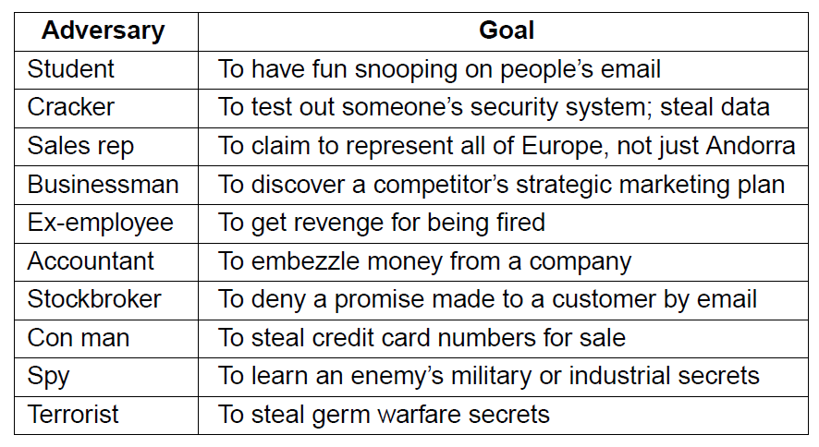
Network Security
Some people who cause security problems and why.

Slide 7
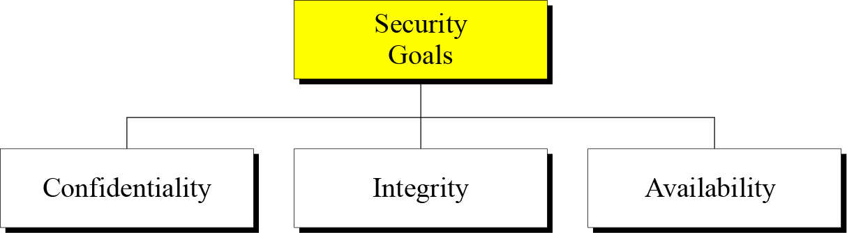
Network Security Goals

Slide 8
Network Security Goals
Confidentiality is probably the most common aspect of information security. We need to protect our confidential information. An organization needs to guard against those malicious actions that endanger the confidentiality of its information.
Integrity: Information needs to be changed constantly. Integrity means that changes need to be done only by authorized entities and through authorized mechanisms.
Availability: The information created and stored by an organization needs to be available to authorized entities. Information needs to be constantly changed, which means it must be accessible to authorized entities.
.

Slide 9
Possible additional concepts:
Authenticity
Verifying that users are who they say they are and that each input arriving at the system came from a trusted source
Accountability
The security goal that generates the requirement for actions of an entity to be traced uniquely to that entity

Slide 10
OSI Security Architecture
ITU-T Recommendation X.800, Security Architecture for OSI describes a systematic way of defining the requirements for security and characterizing the approaches to satisfying those requirements. Focus
Security attack
Any action that compromises the security of information owned by an organization
Security mechanism
A process (or a device incorporating such a process) that is designed to detect, prevent, or recover from a security attack
Security service
A processing or communication service that enhances the security of the data processing systems and the information transfers of an organization
Intended to counter security attacks, and they make use of one or more security mechanisms to provide the service

Slide 11
Security Attacks
A means of classifying security attacks, used both in X.800 and RFC 4949, is in terms of passive attacks and active attacks
A passive attack attempts to learn or make use of information from the system but does not affect system resources
An active attack attempts to alter system resources or affect their operation

Slide 12
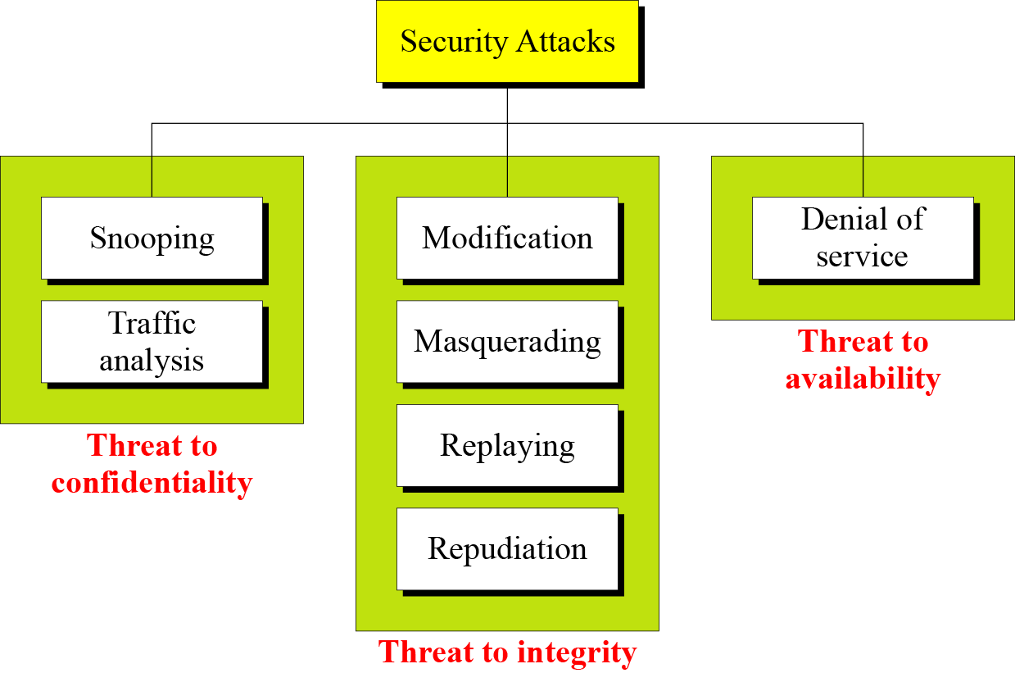
ATTACKS
The three goals of security⎯confidentiality, integrity, and availability⎯can be threatened by security attacks.

Slide 13
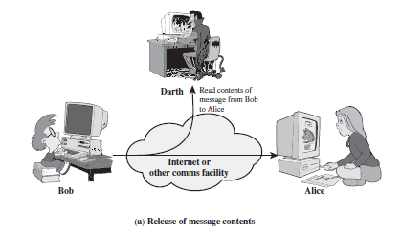
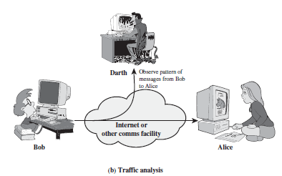
PASSIVE ATTACKS
Snooping refers to unauthorized access to or interception of data.
Traffic analysis refers to obtaining some other type of information by monitoring online traffic.

Slide 14
Active Attacks
Modification means that the attacker intercepts the message and changes it.
Masquerading or spoofing happens when the attacker impersonates somebody else.
Replaying means the attacker obtains a copy of a message sent by a user and later tries to replay it.
Repudiation means that sender of the message might later deny that she has sent the message; the receiver of the message might later deny that he has received the message.

Slide 15
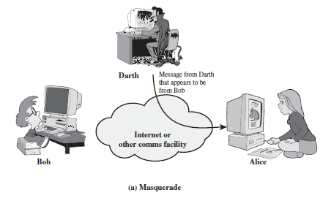
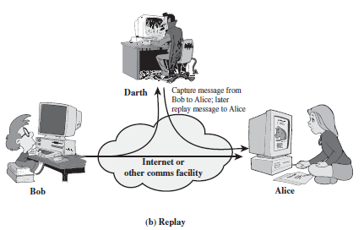
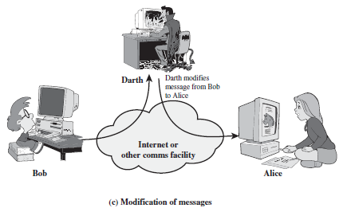
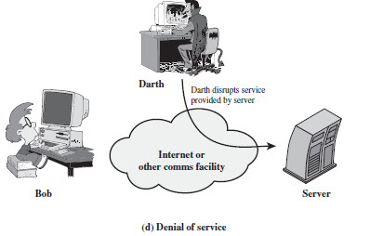
Active attacks

Slide 16
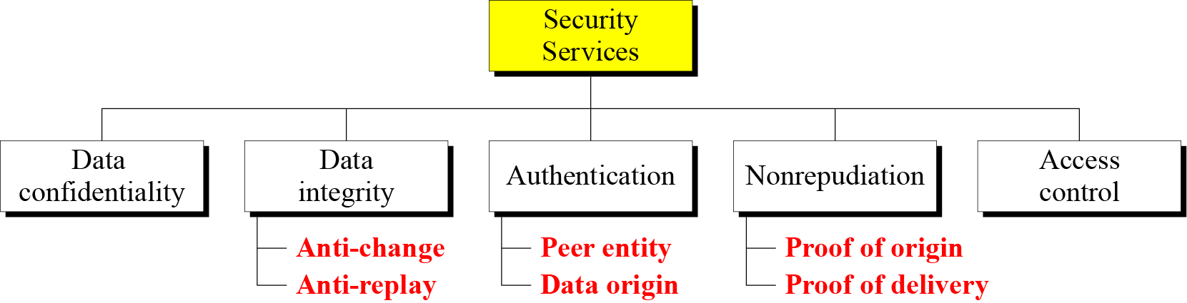
SERVICES AND MECHANISMS
ITU-T provides some security services and some mechanisms to implement those services. Security services and mechanisms are closely related because a mechanism or combination of mechanisms are used to provide a service.
X.800 divides these services into five categories and fourteen specific services

Slide 17
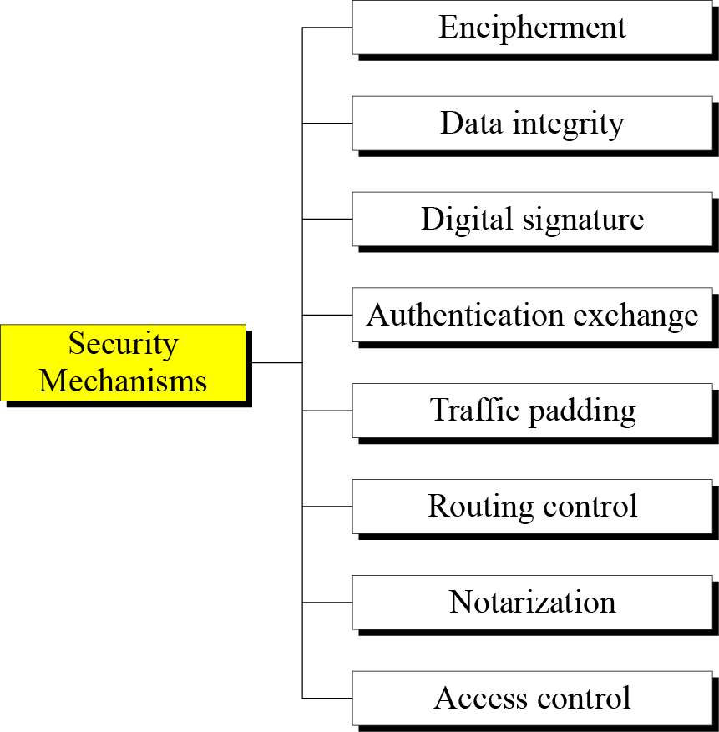
Security Mechanisms (X.800)
Specific security mechanisms: incorporated into the appropriate protocol layer in order to provide some of the OSI security services

Slide 18
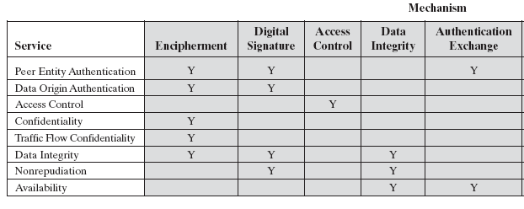
Relationship Between Security Services and Mechanisms

Slide 19
Outline
Introduction
What is network security?
Why is network security important?
What are the requirements for a secure network?
An introduction to Cryptography
Symmetric Key Cryptography
Public Key Cryptography
Authentication
Integrity
Security in Internet protocol stack

Slide 20
Cryptography
From the Greek words: ‘Cryptos’ (= secret) and ‘Grafien’ (= writing)
From ancient times to around 30 years ago: essentially private communications for personal, political and military matters
Today: study and application of techniques relying on the existence of hard problems
A lot of historic uses of Cryptography...

Slide 21
Cryptography
Introduction
Substitution ciphers
Transposition ciphers
One-time pads
Fundamental cryptographic principles

Slide 22
Cryptographic Algorithms
Symmetric encryption: Used to conceal the contents of blocks or streams of data of any size, including messages, files, encryption keys and passwords.
Asymmetric encryption: Used to conceal small blocks of data, such as encryption keys and hash function values, which are used in digital signatures.
Data integrity algorithms: Used to protect blocks of data, such as messages, from alteration.
Authentication protocols: These are schemes based on the use of cryptographic algorithms designed to authenticate the identity of entities.

Slide 23
Terminology
Plaintext original message
Ciphertext encrypted or coded message
Encryption convert from plaintext to ciphertext (enciphering)
Decryption restore the plaintext from ciphertext (deciphering)
Key information used in cipher known only to sender/receiver
Cipher a particular algorithm (cryptographic system)
Cryptography study of algorithms used for encryption
Cryptanalysis study of techniques for decryption without
knowledge of plaintext
Cryptology areas of cryptography and cryptanalysis
Steganography: Hiding data in image or documents

Slide 24
Characterizing Cryptographic Systems
Operations used for encryption:
Substitution replace one element in plaintext with another
Transposition re-arrange elements
Product systems multiple stages of substitutions and transpositions
Number of keys used:
Symmetric sender/receiver use same key (single-key, secret-key, shared-key, conventional)
Public-key sender/receiver use dierent keys (asymmetric)
Processing of plaintext:
Block cipher process one block of elements at a time
Stream cipher process input elements continuously

Slide 25
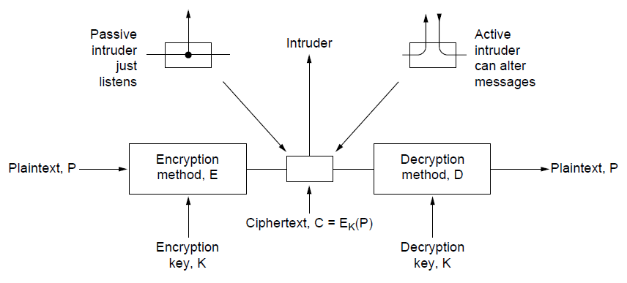
Encryption Model
The encryption model (for a symmetric-key cipher).

Slide 26
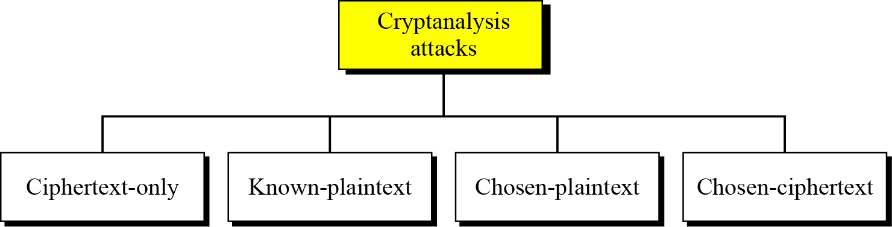
Cryptanalysis
As cryptography is the science and art of creating secret codes, cryptanalysis is the science and art of breaking those codes.
Cryptanalysis attacks

Slide 27
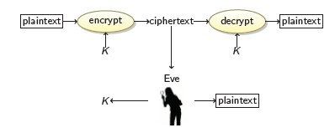
Cryptanalysis (Cont.)
Ciphertext-only attack
We have: the ciphertext of several messages that have been encrypted with the same key, K.
We recover: the plaintexts, or K.

Slide 28
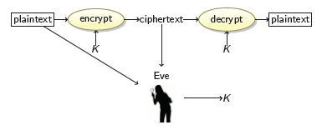
Cryptanalysis (Cont.)
Known-Plaintext Attack
We have: the ciphertexts and corresponding plaintexts of several messages, all encrypted with the same key K.
We recover: the key K.

Slide 29
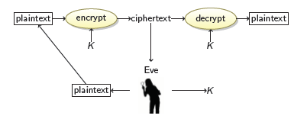
Cryptanalysis (Cont.)
Chosen-Plaintext Attack
We have: the ciphertext of several messages that have been encrypted with the same key K, such that we get to choose the plaintexts.
We recover: the key K.

Slide 30
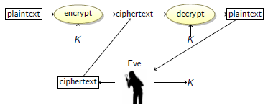
Cryptanalysis (Cont.)
Chosen-Ciphertext Attack
We have: the plaintext of several messages that have been encrypted with the same key K, such that we get to choose the ciphertexts.
We recover: the key K.

Slide 31
Substitution ciphers
A substitution cipher replaces one symbol with another. Substitution ciphers can be categorized as either monoalphabetic ciphers or polyalphabetic ciphers.
A substitution cipher replaces one symbol with another.
Topics:
Monoalphabetic Ciphres Polyalphabetic Ciphers

Slide 32
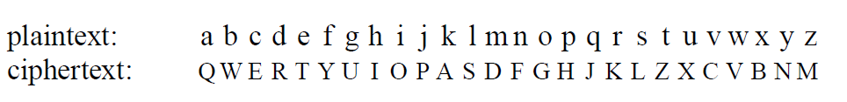
Substitution Ciphers
Monoalphabetic substitution

Slide 33
Polyalphabetic encryption
n monoalphabetic cyphers, M₁,M₂,…,M_{n}
Cycling pattern:
e.g., for n=4: M₁,M₃,M₄,M₃,M₂; M₁,M₃,M₄,M₃,M₂;
For each new plaintext symbol, use subsequent monoalphabetic pattern in cyclic pattern
‘dog’: d from M₁, o from M₃, g from M₄
Key: the n ciphers and the cyclic pattern

Slide 34
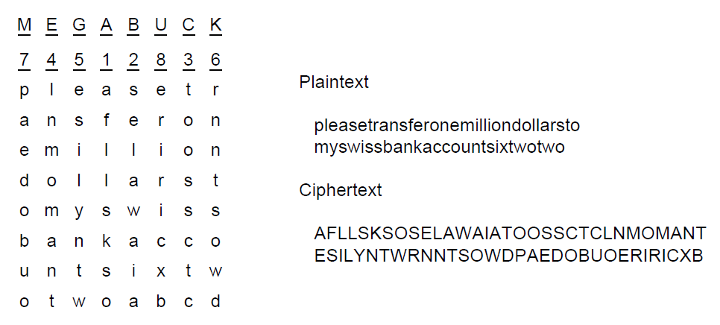
Transposition Ciphers
A transposition cipher

Slide 35
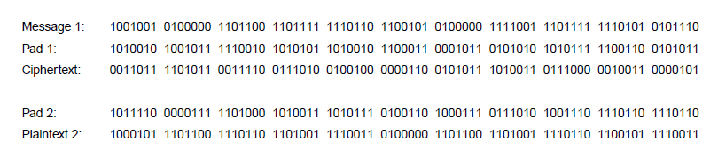
One-Time Pads (1)
The use of a one-time pad for encryption and the possibility of getting any possible plaintext from the ciphertext by the use of some other pad.

Slide 36
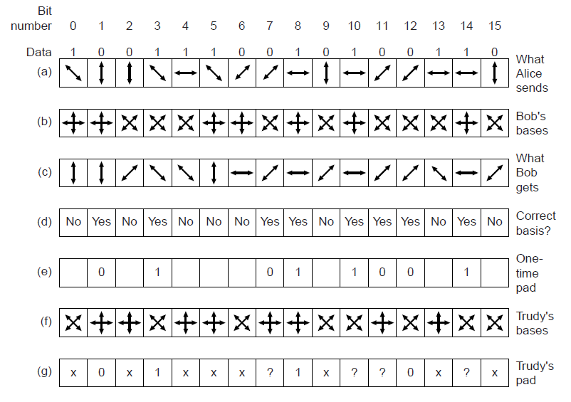
One-Time Pads: How to share secret key using quantum cryptography
An example of quantum cryptography

Slide 37
Two types of symmetric ciphers
Block ciphers
Break plaintext message in equal-size blocks
Encrypt each block as a unit
Stream ciphers
encrypt one bit at time

Slide 38
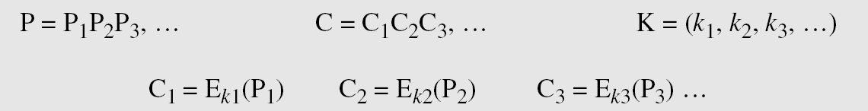
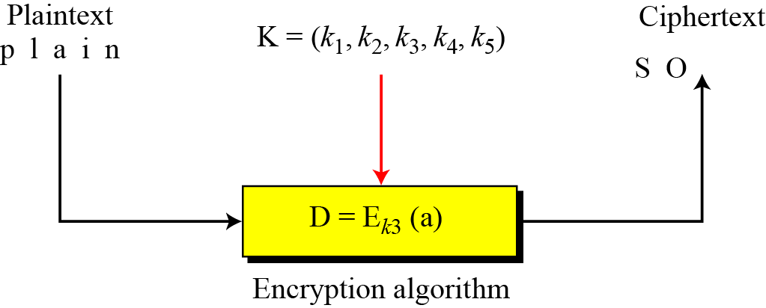
Stream Ciphers
Call the plaintext stream P, the ciphertext stream C, and the key stream K.
Figure Stream cipher

Slide 39
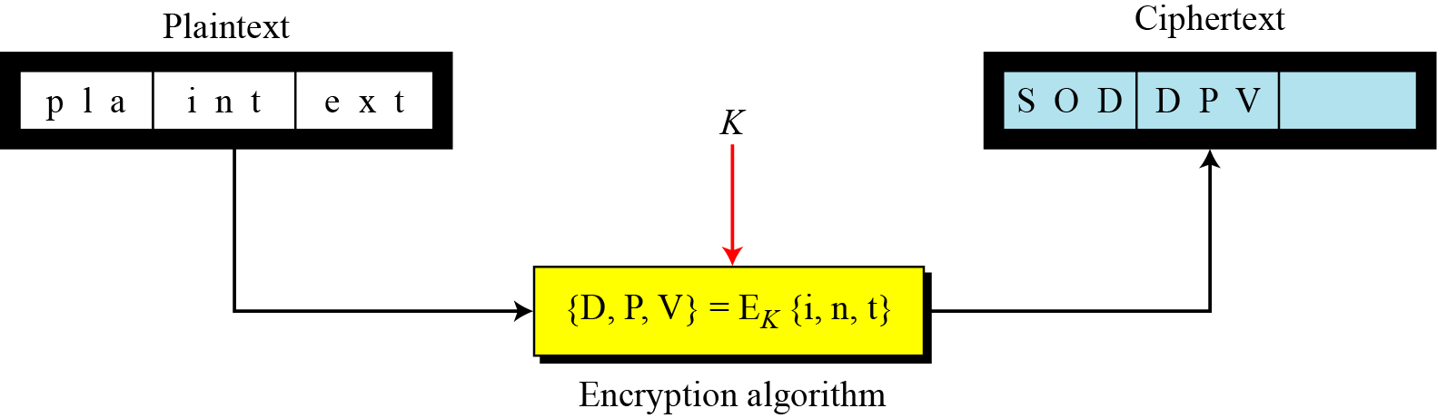
Block Ciphers
In a block cipher, a group of plaintext symbols of size m (m > 1) are encrypted together creating a group of ciphertext of the same size. A single key is used to encrypt the whole block even if the key is made of multiple values. Figure 3.27 shows the concept of a block cipher.
Figure Block cipher

Slide 40
Fundamental Cryptographic Principles
Messages must contain some redundancy
Some method is needed to foil replay attacks

Slide 41
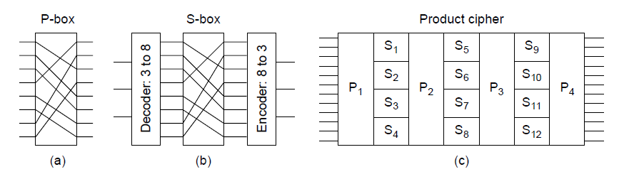
Symmetric-key Algorithms (1)
Basic elements of product ciphers. (a) P-box. (b) S-box. (c) Product.

Slide 42
Symmetric-key Algorithms (2)
Data encryption standard
Advanced encryption standard
Cipher modes
Other ciphers
Cryptanalysis

Slide 43
Symmetric key crypto: DES
DES operation
initial permutation
16 identical “rounds” of function application, each using different 48 bits of key
final permutation

Slide 44
Chapter goals:
understand principles of network security:
cryptography and its many uses beyond “confidentiality”
authentication
message integrity
security in practice:
firewalls and intrusion detection systems
security in application, transport, network, link layers

Slide 45
Chapter 8 roadmap
8.1 What is network security?
8.2 Principles of cryptography
8.3 Message integrity, authentication
8.4 Securing e-mail
8.5 Securing TCP connections: SSL
8.6 Network layer security: IPsec
8.7 Securing wireless LANs
8.8 Operational security: firewalls and IDS

Slide 46
What is network security?
confidentiality: only sender, intended receiver should “understand” message contents
sender encrypts message
receiver decrypts message
authentication: sender, receiver want to confirm identity of each other
message integrity: sender, receiver want to ensure message not altered (in transit, or afterwards) without detection
access and availability: services must be accessible and available to users

Slide 47



Friends and enemies: Alice, Bob, Trudy
well-known in network security world
Bob, Alice (lovers!) want to communicate “securely”
Trudy (intruder) may intercept, delete, add messages
Alice
Bob
channel
data, control messages
secure
sender
s
data
secure
receiver
data
Trudy

Slide 48
Who might Bob, Alice be?
… well, real-life Bobs and Alices!
Web browser/server for electronic transactions (e.g., on-line purchases)
on-line banking client/server
DNS servers
routers exchanging routing table updates
other examples?

Slide 49
There are bad guys (and girls) out there!
Q: What can a “bad guy” do?
A: A lot! See section 1.6
eavesdrop: intercept messages
actively insert messages into connection
impersonation: can fake (spoof) source address in packet (or any field in packet)
hijacking: “take over” ongoing connection by removing sender or receiver, inserting himself in place
denial of service: prevent service from being used by others (e.g., by overloading resources)

Slide 50
Chapter 8 roadmap
8.1 What is network security?
8.2 Principles of cryptography
8.3 Message integrity, authentication
8.4 Securing e-mail
8.5 Securing TCP connections: SSL
8.6 Network layer security: IPsec
8.7 Securing wireless LANs
8.8 Operational security: firewalls and IDS

Slide 51
The language of cryptography
Alice’s
encryption
key
Bob’s
decryption
key
K
K
A
B
plaintext
encryption
algorithm
ciphertext
decryption
algorithm
plaintext
m plaintext message
K_{A}(m) ciphertext, encrypted with key K_{A}
m = K_{B}(K_{A}(m))

Slide 52
Breaking an encryption scheme
cipher-text only attack: Trudy has ciphertext she can analyze
two approaches:
brute force: search through all keys
statistical analysis
known-plaintext attack: Trudy has plaintext corresponding to ciphertext
e.g., in monoalphabetic cipher, Trudy determines pairings for a,l,i,c,e,b,o,
chosen-plaintext attack: Trudy can get ciphertext for chosen plaintext

Slide 53
Symmetric key cryptography
K
K
S
S
plaintext
message, m
encryption
algorithm
ciphertext
decryption
algorithm
plaintext
K (m)
m = K_{S}(K_{S}(m))
S
symmetric key crypto: Bob and Alice share same (symmetric) key: K
e.g., key is knowing substitution pattern in mono alphabetic substitution cipher
Q: how do Bob and Alice agree on key value?
S

Slide 54
Simple encryption scheme
substitution cipher: substituting one thing for another
monoalphabetic cipher: substitute one letter for another
plaintext: abcdefghijklmnopqrstuvwxyz
ciphertext: mnbvcxzasdfghjklpoiuytrewq
e.g.:
Plaintext: bob. i love you. alice
ciphertext: nkn. s gktc wky. mgsbc
Encryption key: mapping from set of 26 letters
to set of 26 letters

Slide 55
A more sophisticated encryption approach
n substitution ciphers, M₁,M₂,…,M_{n}
cycling pattern:
e.g., n=4: M₁,M₃,M₄,M₃,M₂; M₁,M₃,M₄,M₃,M₂; ..
for each new plaintext symbol, use subsequent subsitution pattern in cyclic pattern
dog: d from M₁, o from M₃, g from M₄
Encryption key: n substitution ciphers, and cyclic pattern
key need not be just n-bit pattern

Slide 56
Symmetric key crypto: DES
DES: Data Encryption Standard
US encryption standard [NIST 1993]
56-bit symmetric key, 64-bit plaintext input
block cipher with cipher block chaining
how secure is DES?
DES Challenge: 56-bit-key-encrypted phrase decrypted (brute force) in less than a day
no known good analytic attack
making DES more secure:
3DES: encrypt 3 times with 3 different keys

Slide 57
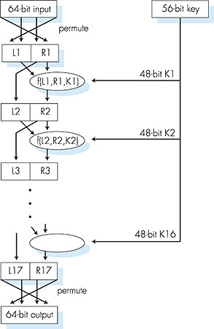
Symmetric key crypto: DES
DES operation
initial permutation
16 identical “rounds” of function application, each using different 48 bits of key
final permutation

Slide 58
AES: Advanced Encryption Standard
symmetric-key NIST standard, replacied DES (Nov 2001)
processes data in 128 bit blocks
128, 192, or 256 bit keys
brute force decryption (try each key) taking 1 sec on DES, takes 149 trillion years for AES

Slide 59
Public Key Cryptography
symmetric key crypto
requires sender, receiver know shared secret key
Q: how to agree on key in first place (particularly if never “met”)?
public key crypto
radically different approach [Diffie-Hellman76, RSA78]
sender, receiver do not share secret key
public encryption key known to all
private decryption key known only to receiver

Slide 60
Public key cryptography
+
Bob’s public
key
K
B
-
Bob’s private
key
K
B
plaintext
message, m
encryption
algorithm
ciphertext
decryption
algorithm
plaintext
message
+
K (m)
-
+
B
m = K (K (m))
B
B

Slide 61
Public key encryption algorithms
requirements:
.
.
+
-
1
need K ( ) and K ( ) such that
B
B
-
+
K (K (m)) = m
B
B
2
+
given public key K , it should be impossible to compute private key K
B
-
B
RSA: Rivest, Shamir, Adelson algorithm

Slide 62
Prerequisite: modular arithmetic
x mod n = remainder of x when divide by n
facts:
[(a mod n) + (b mod n)] mod n = (a+b) mod n
[(a mod n) - (b mod n)] mod n = (a-b) mod n
[(a mod n) * (b mod n)] mod n = (a*b) mod n
thus
(a mod n)^{d} mod n = a^{d} mod n
example: x=14, n=10, d=2: (x mod n)^{d} mod n = 4² mod 10 = 6 x^{d} = 14² = 196 x^{d} mod 10 = 6

Slide 63
RSA: getting ready
message: just a bit pattern
bit pattern can be uniquely represented by an integer number
thus, encrypting a message is equivalent to encrypting a number.
example:
m= 10010001 . This message is uniquely represented by the decimal number 145.
to encrypt m, we encrypt the corresponding number, which gives a new number (the ciphertext).

Slide 64
RSA: Creating public/private key pair
1. choose two large prime numbers p, q.
(e.g., 1024 bits each)
2. compute n = pq, z = (p-1)(q-1)
3. choose e (with e<n) that has no common factors
with z (e, z are “relatively prime”).
4. choose d such that ed-1 is exactly divisible by z.
(in other words: ed mod z = 1 ).
5. public key is (n,e). private key is (n,d).
+
-
K
K
B
B

Slide 65
RSA: encryption, decryption
0. given (n,e) and (n,d) as computed above
1. to encrypt message m (<n), compute
e
c = m mod n
2. to decrypt received bit pattern, c, compute
d
m = c mod n
magic
happens!
e
d
m = (m mod n)
mod n
c

Slide 66
RSA example:
Bob chooses p=5, q=7. Then n=35, z=24.
e=5 (so e, z relatively prime).
d=29 (so ed-1 exactly divisible by z).
encrypting 8-bit messages.
m
e
e
bit pattern
m
c = m mod n
encrypt:
0000l000
12
24832
17
d
d
c
c
m = c mod n
decrypt:
17
481968572106750915091411825223071697
12

Slide 67
Why does RSA work?
must show that c^{d} mod n = m where c = m^{e} mod n
fact: for any x and y: x^{y} mod n = x^{(y mod z)} mod n
where n= pq and z = (p-1)(q-1)
thus, c^{d} mod n = (m^{e} mod n)^{d} mod n
= m^{ed} mod n
= m^{(ed mod z)} mod n
= m¹ mod n
= m

Slide 68
RSA: another important property
The following property will be very useful later:
-
+
+
-
K (K (m)) = m
=
K (K (m))
B
B
B
B
use public key first, followed by private key
use private key first, followed by public key
result is the same!

Slide 69
Why
-
+
+
-
K (K (m)) = m
?
=
K (K (m))
B
B
B
B
follows directly from modular arithmetic:
(m^{e} mod n)^{d} mod n = m^{ed} mod n
= m^{de} mod n
= (m^{d} mod n)^{e} mod n

Slide 70
Why is RSA secure?
suppose you know Bob’s public key (n,e). How hard is it to determine d?
essentially need to find factors of n without knowing the two factors p and q
fact: factoring a big number is hard

Slide 71
RSA in practice: session keys
exponentiation in RSA is computationally intensive
DES is at least 100 times faster than RSA
use public key cryto to establish secure connection, then establish second key – symmetric session key – for encrypting data
session key, K_{S}
Bob and Alice use RSA to exchange a symmetric key K_{S}
once both have K_{S}, they use symmetric key cryptography

Slide 72
Chapter 8 roadmap
8.1 What is network security?
8.2 Principles of cryptography
8.3 Message integrity, authentication
8.4 Securing e-mail
8.5 Securing TCP connections: SSL
8.6 Network layer security: IPsec
8.7 Securing wireless LANs
8.8 Operational security: firewalls and IDS

Slide 73
Authentication
Goal: Bob wants Alice to “prove” her identity to him
Protocol ap1.0: Alice says “I am Alice”
“I am Alice”
Failure scenario??

Slide 74
Authentication
Goal: Bob wants Alice to “prove” her identity to him
Protocol ap1.0: Alice says “I am Alice”
in a network,
Bob can not “see” Alice, so Trudy simply declares
herself to be Alice
“I am Alice”

Slide 75
Authentication: another try
Protocol ap2.0: Alice says “I am Alice” in an IP packet
containing her source IP address
Alice’s
IP address
“I am Alice”
Failure scenario??

Slide 76
Authentication: another try
Protocol ap2.0: Alice says “I am Alice” in an IP packet
containing her source IP address
Trudy can create
a packet “spoofing”
Alice’s address
Alice’s
IP address
“I am Alice”

Slide 77
Authentication: another try
Protocol ap3.0: Alice says “I am Alice” and sends her
secret password to “prove” it.
Alice’s
IP addr
Alice’s
password
“I’m Alice”
Failure scenario??
Alice’s
IP addr
OK

Slide 78
Authentication: another try
Protocol ap3.0: Alice says “I am Alice” and sends her
secret password to “prove” it.
Alice’s
IP addr
Alice’s
password
“I’m Alice”
playback attack: Trudy records Alice’s packet
and later
plays it back to Bob
Alice’s
IP addr
OK
Alice’s
IP addr
Alice’s
password
“I’m Alice”

Slide 79
Authentication: yet another try
Protocol ap3.1: Alice says “I am Alice” and sends her
encrypted secret password to “prove” it.
Alice’s
IP addr
encrypted
password
“I’m Alice”
Failure scenario??
Alice’s
IP addr
OK

Slide 80
Authentication: yet another try
Protocol ap3.1: Alice says “I am Alice” and sends her
encrypted secret password to “prove” it.
Alice’s
IP addr
encrypted
password
“I’m Alice”
record
and
playback
still works!
Alice’s
IP addr
OK
Alice’s
IP addr
encrypted
password
“I’m Alice”

Slide 81
Authentication: yet another try
Goal: avoid playback attack
nonce: number (R) used only once-in-a-lifetime
ap4.0: to prove Alice “live”, Bob sends Alice nonce, R. Alice
must return R, encrypted with shared secret key
“I am Alice”
R
K (R)
Alice is live, and only Alice knows key to encrypt nonce, so it must be Alice!
A-B
Failures, drawbacks?

Slide 82
Authentication: ap5.0
ap4.0 requires shared symmetric key
can we authenticate using public key techniques?
ap5.0: use nonce, public key cryptography
“I am Alice”
Bob computes
R
+
-
-
K
(K (R)) = R
K (R)
A
A
A
and knows only Alice could have the private key, that encrypted R such that
“send me your public key”
+
K
A
+
-
K
(K (R)) = R
A
A

Slide 83
ap5.0: security hole
man (or woman) in the middle attack: Trudy poses as Alice (to Bob) and as Bob (to Alice)
I am Alice
I am Alice
R
-
K (R)
T
R
-
Send me your public key
K (R)
+
A
K
T
Send me your public key
+
K
A
+
K (m)
Trudy gets
T
-
+
+
m = K (K (m))
K (m)
T
T
-
A
sends m to Alice encrypted with Alice’s public key
+
m = K (K (m))
A
A

Slide 84
ap5.0: security hole
man (or woman) in the middle attack: Trudy poses as Alice (to Bob) and as Bob (to Alice)
difficult to detect:
Bob receives everything that Alice sends, and vice versa. (e.g., so Bob, Alice can meet one week later and recall conversation!)
problem is that Trudy receives all messages as well!

Slide 85
Chapter 8 roadmap
8.1 What is network security?
8.2 Principles of cryptography
8.3 Message integrity, authentication
8.4 Securing e-mail
8.5 Securing TCP connections: SSL
8.6 Network layer security: IPsec
8.7 Securing wireless LANs
8.8 Operational security: firewalls and IDS

Slide 86
Digital signatures
cryptographic technique analogous to hand-written signatures:
sender (Bob) digitally signs document, establishing he is document owner/creator.
verifiable, nonforgeable: recipient (Alice) can prove to someone that Bob, and no one else (including Alice), must have signed document

Slide 87
Digital signatures
simple digital signature for message m:
Bob signs m by encrypting with his private key K_{B}, creating “signed” message, K_{B}(m)
-
-
Bob’s message, m
-
Bob’s private
key
-
K
m,K
(m)
B
B
Dear Alice
Oh, how I have missed you. I think of you all the time! …(blah blah blah)
Bob
Bob’s message, m, signed (encrypted) with his private key
Public key
encryption
algorithm

Slide 88
Digital signatures
-
suppose Alice receives msg m, with signature: m, K_{B}(m)
Alice verifies m signed by Bob by applying Bob’s public key K_{B} to K_{B}(m) then checks K_{B}(K_{B}(m) ) = m.
If K_{B}(K_{B}(m) ) = m, whoever signed m must have used Bob’s private key.
+
-
+
-
+
-
Alice thus verifies that:
Bob signed m
no one else signed m
Bob signed m and not m‘
non-repudiation:
Alice can take m, and signature K_{B}(m) to court and prove that Bob signed m
-

Slide 89
Message digests
large
message
m
H: Hash
Function
computationally expensive to public-key-encrypt long messages
goal: fixed-length, easy- to-compute digital “fingerprint”
apply hash function H to m, get fixed size message digest, H(m).
H(m)
Hash function properties:
many-to-1
produces fixed-size msg digest (fingerprint)
given message digest x, computationally infeasible to find m such that x = H(m)

Slide 90
Internet checksum: poor crypto hash function
Internet checksum has some properties of hash function:
produces fixed length digest (16-bit sum) of message
is many-to-one
But given message with given hash value, it is easy to find another message with same hash value:
message
ASCII format
message
ASCII format
I O U 1
0 0 . 9
9 B O B
49 4F 55 31
30 30 2E 39
39 42 D2 42
I O U 9
0 0 . 1
9 B O B
49 4F 55 39
30 30 2E 31
39 42 D2 42
B2 C1 D2 AC
different messages
but identical checksums!
B2 C1 D2 AC

Slide 91
Digital signature = signed message digest
Bob sends digitally signed message:
Alice verifies signature, integrity of digitally signed message:
large
message
m
H: Hash
function
H(m)
encrypted
msg digest
-
K_{B}(H(m))
Bob’s
private
key
digital
signature
(encrypt)
large
message
m
-
Bob’s
public
key
digital
signature
(decrypt)
K
B
+
H: Hash
function
K
encrypted
msg digest
B
+
-
K_{B}(H(m))
H(m)
H(m)
equal
?

Slide 92
Hash function algorithms
MD5 hash function widely used (RFC 1321)
computes 128-bit message digest in 4-step process.
arbitrary 128-bit string x, appears difficult to construct msg m whose MD5 hash is equal to x
SHA-1 is also used
US standard [NIST, FIPS PUB 180-1]
160-bit message digest

Slide 93
Recall: ap5.0 security hole
man (or woman) in the middle attack: Trudy poses as Alice (to Bob) and as Bob (to Alice)
I am Alice
I am Alice
R
-
K (R)
T
R
-
Send me your public key
K (R)
+
A
K
T
Send me your public key
+
K
A
+
K (m)
Trudy gets
T
-
+
+
m = K (K (m))
K (m)
T
T
-
A
sends m to Alice encrypted with Alice’s public key
+
m = K (K (m))
A
A

Slide 94
Public-key certification
motivation: Trudy plays pizza prank on Bob
Trudy creates e-mail order: Dear Pizza Store, Please deliver to me four pepperoni pizzas. Thank you, Bob
Trudy signs order with her private key
Trudy sends order to Pizza Store
Trudy sends to Pizza Store her public key, but says it’s Bob’s public key
Pizza Store verifies signature; then delivers four pepperoni pizzas to Bob
Bob doesn’t even like pepperoni

Slide 95
Certification authorities
certification authority (CA): binds public key to particular entity, E.
E (person, router) registers its public key with CA.
E provides “proof of identity” to CA.
CA creates certificate binding E to its public key.
certificate containing E’s public key digitally signed by CA – CA says “this is E’s public key”
Bob’s
public
key
digital
signature
(encrypt)
+
K
+
B
K
B
CA
private
key
certificate for Bob’s public key, signed by CA
-
Bob’s
identifying information
K
CA

Slide 96
Certification authorities
when Alice wants Bob’s public key:
gets Bob’s certificate (Bob or elsewhere).
apply CA’s public key to Bob’s certificate, get Bob’s public key
+
digital
signature
(decrypt)
Bob’s
public
key
K
B
+
K
B
CA
public
key
+
K
CA

Slide 97
Network Security (summary)
basic techniques…...
cryptography (symmetric and public)
message integrity
end-point authentication
…. used in many different security scenarios
secure email
secure transport (SSL)
IP sec
802.11
operational security: firewalls and IDS

